Slide 1
Finished Goods Lot# With Sharp Shooter

Slide 2
1) Create Case Labels
2) Scan Case Label to create Load Tags
3) Scan Load Tags to Receive Finished Goods
Note: Scanning the load tag is not required to create a FG Receipt. Receipts can be created at the same time the load tag is created. Also, posting can be a separate step or also happen at the time the Load tag is created.

Slide 3
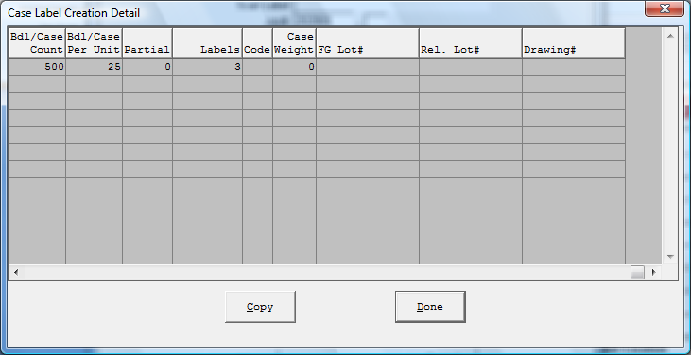
Case Label Creation
The FG Lot# can be entered at the time, the case label is created.
Entering a FG Lot# on the case label will automatically transfer to the load tag file when creating the load tag.

Slide 4
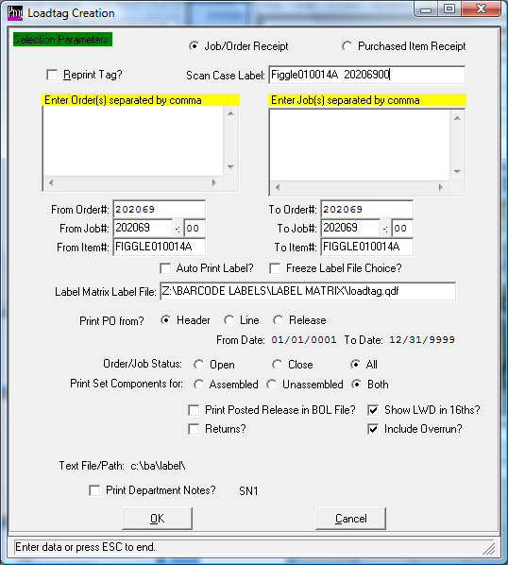
Scanning the Case Label
You can scan the case label to create the load tag. If the FG Lot# was entered on the case label, this will pull into the Load tag creation program and also get transferred to the FG receipt. When posting the FG receipts the history file will show the FG Lot#.

Slide 5
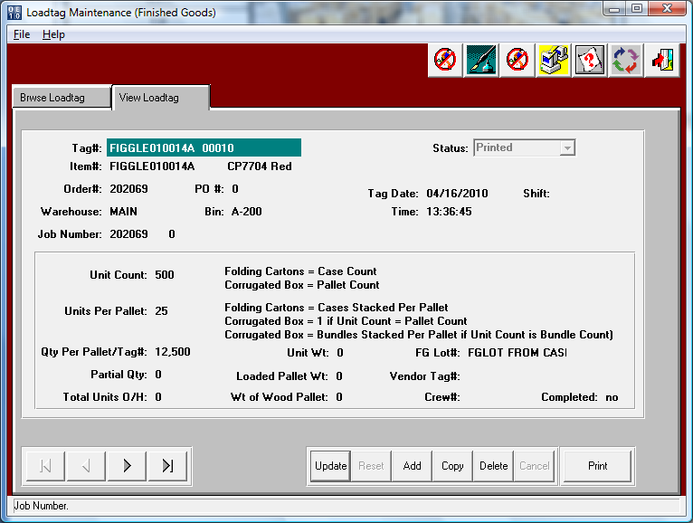
Load Tag file
This Load tag Maintenance file gets created automatically when creating a load tag.
The FG Lot# will be stored in the Load tag file.

